Slide 1
Web Scrapping using Scrapy

Slide 2
Installing scrapy :
To install Scrapy using conda, run this command in the command prompt(write down the following command in anaconda command prompt):
conda install -c conda-forge scrapy
You can install Scrapy and its dependencies from PyPI with the following command:
pip install Scrapy

Slide 3
WEB SCRAPPING:
Web scraping is about downloading structured data from the web, selecting some of that data, and passing along what you selected to another process.
SCRAPY:
Scrapy is an application framework for crawling web sites and extracting structured data which can be used for a wide range of useful applications, like data mining, information processing or historical archival, testing.

Slide 4
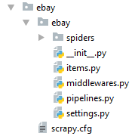
STEPS TO CREATE A SCRAPY PROJECT :
STARTING PROJECT:
Open pycharm.
Open the folder where your project will be created.
Go to the terminal in the bottom left of the pycharm window.
Write command: scrapy startproject ebay
The project is create in the folder with the following directories :

Slide 5
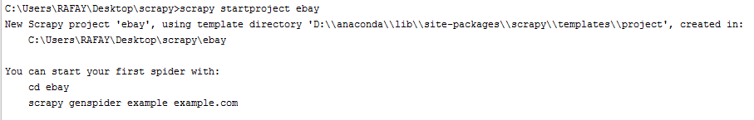

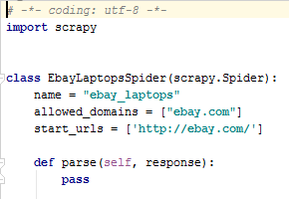
STEPS TO CREATE A SCRAPY PROJECT :
Now move to the project directory by typing in terminal:
Now we will create our first crawler/spider by typing:
Ebay_laptops.py file will be created:

Slide 6
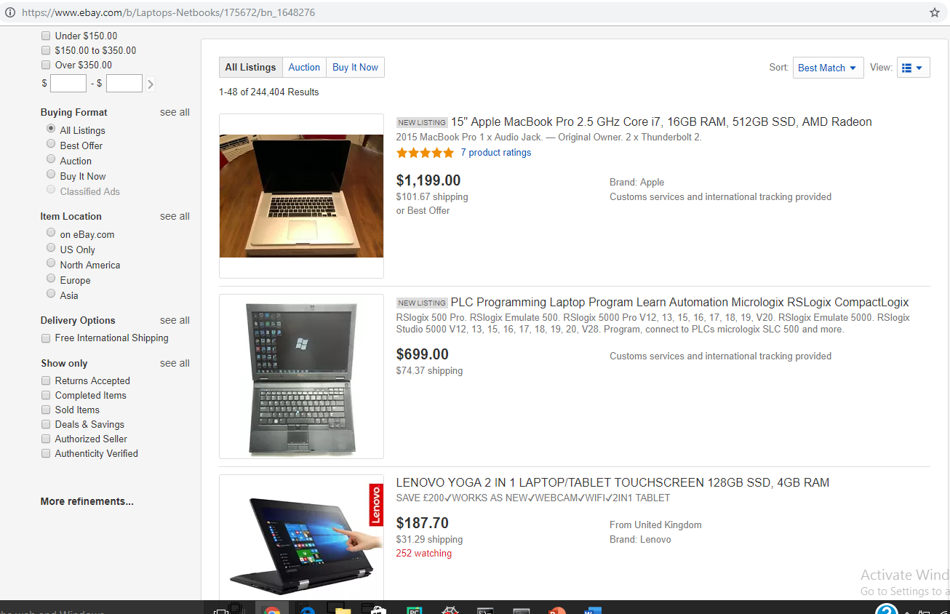
STEPS TO CREATE A SCRAPY PROJECT :
Now we are going to scrap this web page:
We will scrap:
Title
Price
Image_link

Slide 7
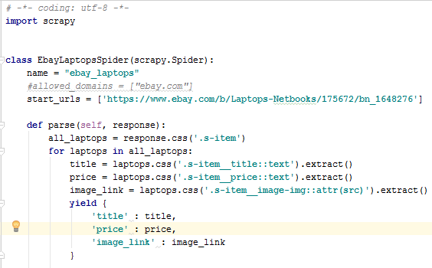
STEPS TO CREATE A SCRAPY PROJECT :
Now the function “parse” in ebay_laptops.py look like this.
We have inserted response.css(‘html_tag.class_name’)
“::text” (use double quotes) is used to take out the data in the text format.
“::attr(src)” takes out attribute value from src.
Code file
Yield is used to give the output.
Now go to the terminal and type : scrapy crawl ebay_laptops to start crawler.
The extracted data will be displayed in the form of list in the terminal.

Slide 8
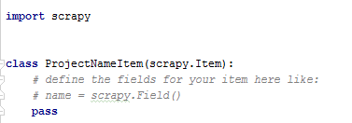
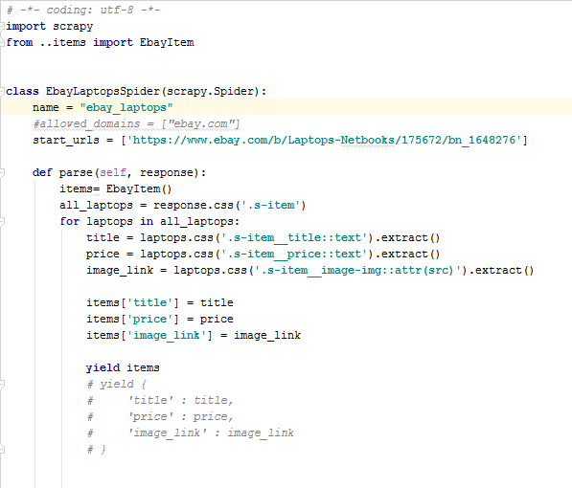
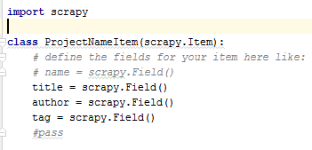
STORING DICTIONARY IN TEMPORARY CONTAINER
Now we will store the scraped data in a temporary container ‘items’
Go to items.py
Create variables for scraped data:
Code file
3. Write the following code in ebay_laptops.py
Code file

Slide 9
STORING IN DIFFERENT FORMATS
Now we can also store the output in .csv , .json , .xml format by typing command in terminal:
scrapy crawl ebay_laptops –o items.json
Or
scrapy crawl ebay_laptops –o items.xml
Or
scrapy crawl ebay_laptops –o items.csv

Slide 10
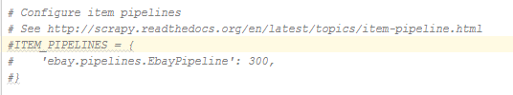

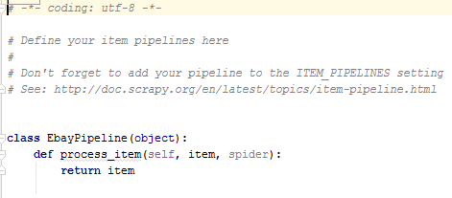
STORING IN DATABASE
Now we will store the items in sqlite3 database.
First go to the settings.py and uncomment the pipeline command.
The number describe the priority.
Open pipelines.py file

Slide 11
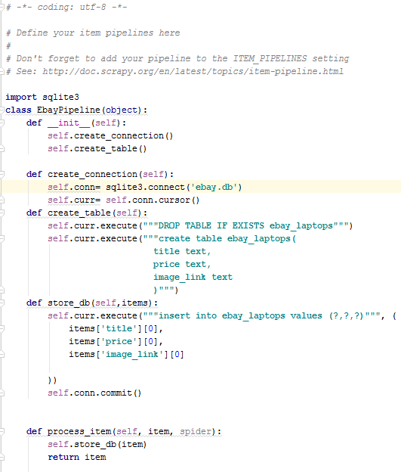
STORING IN DATABASE
Type the following code in pipelines.py
Code file

Slide 12
__init__ :
"__init__" is a reseved method in python classes. It is called as a constructor in object oriented terminology. This method is called when an object is created from a class and it allows the class to initialize the attributes of the class.
self :
self represents the instance of the class. By using the "self" keyword we can access the attributes and methodsof the class in python.

